Slide 1
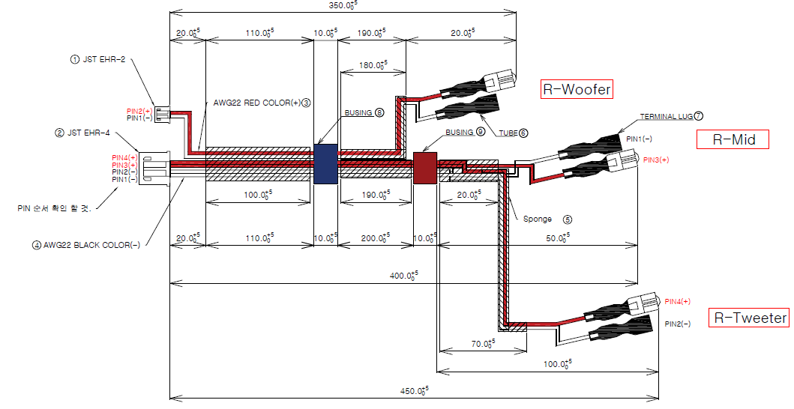
CABLE_SPEAKER_CORD_ASSY_right
90mm
45mm

Slide 2
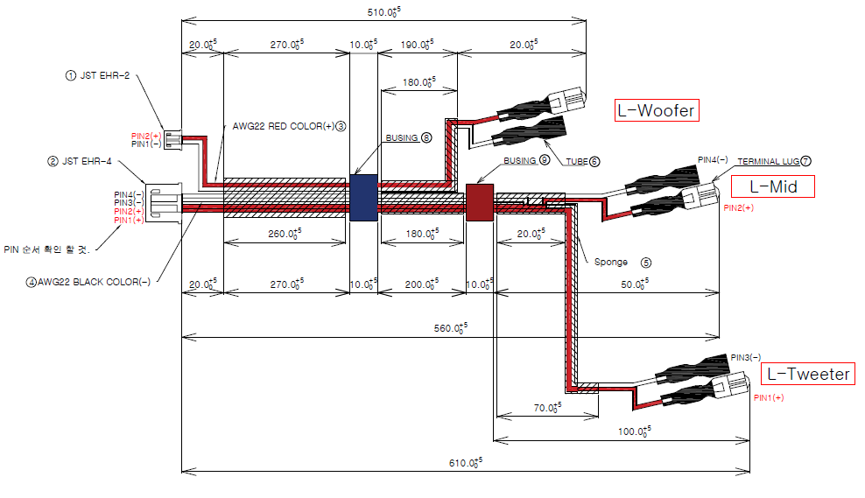
CABLE_SPEAKER_CORD_ASSY_left
160mm
245mm

